Slide 1
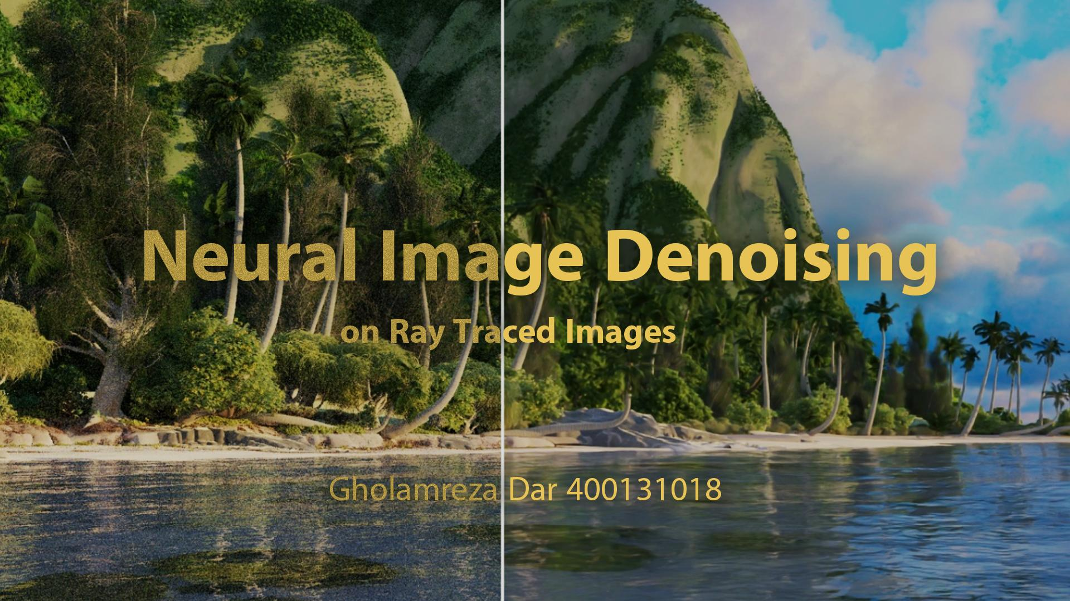
Cover image courtesy of Intel

Slide 2
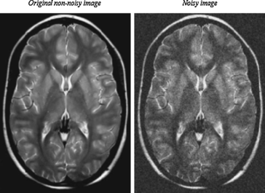
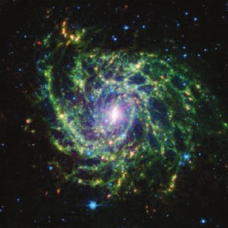
Image Denoising
Removal (Reduction?) of noise from an image
Used as a pre-process step or a post-process step
Applicable to
Medical images
Astronomical images
Ray traced images
...
© Abdeldjalil Ouahabi
© John Jenkinson et al.

Slide 3

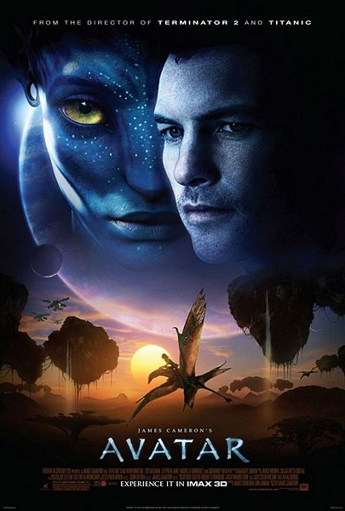

What is Ray Tracing?
Ray tracing is a technique for modeling light transport for use in a wide variety of rendering algorithms for generating digital images. (Taken from Wikipedia)
Hollywood has been using Ray tracing for over 20 years now!
Highly valuable in the industry
$2.06 Billion
$2.84 Billion
$2.79 Billion
© Lucasfilm Ltd.
© 20th Century Fox
© Marvel Studios

Slide 4
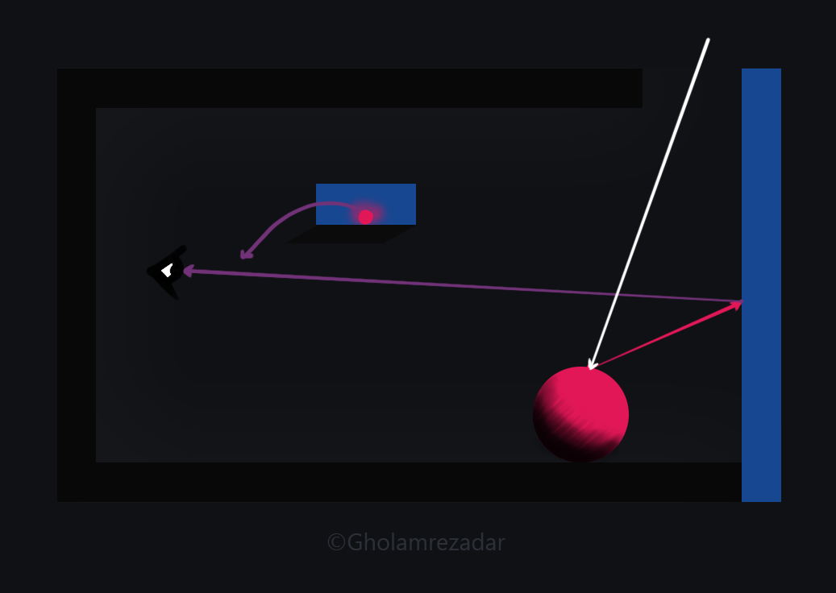
Ray Tracing in Action

Slide 5
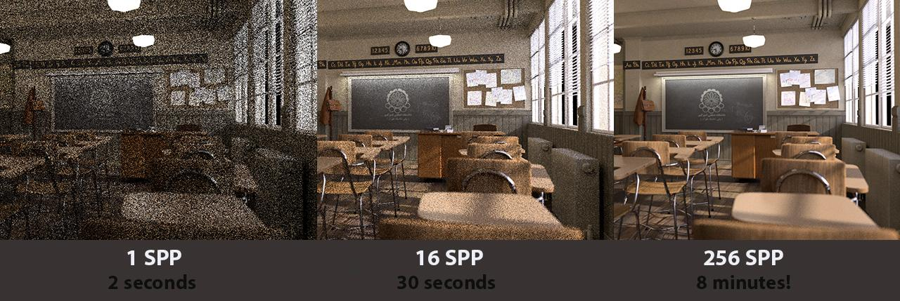
Effect of Sample Size
© “Classroom” scene by Christophe Seux, Renders and comparison by Gholamreza Dar

Slide 6
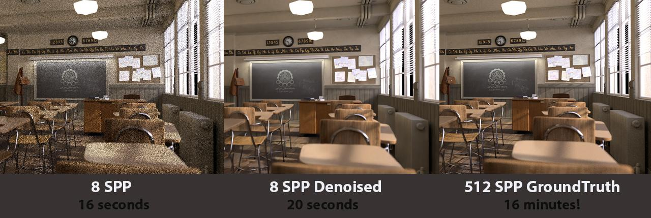
Solution: “Denoising”
© “Classroom” scene by Christophe Seux, Renders and comparison by Gholamreza Dar

Slide 7
How to Denoise?
What is Denoising?
Why is Denoising important?
How is Denoising done?
Spatial domain filtering methods (classic)
Mean filtering
Median filtering
…
Transform Domain filtering methods (classic)
Spatial Frequency Filtering
Wavelet domain filtering
Auto Encoders and CNNs
© Alisha P B - Image Denoising Techniques-An Overview 2016

Slide 8
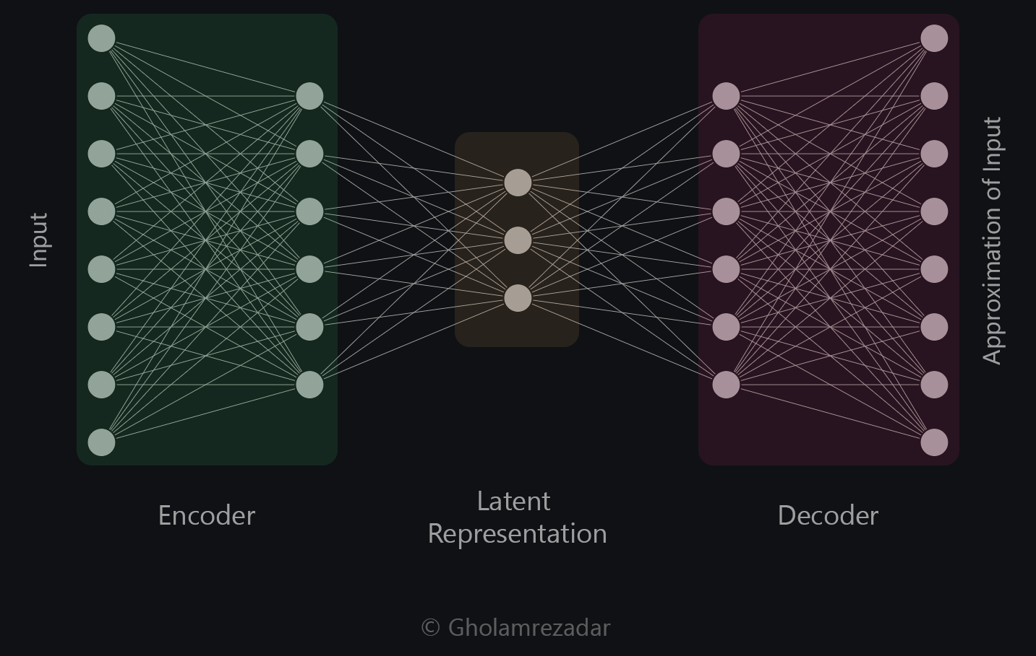
Auto Encoders
Comprised of an Encoder and a Decoder part
Minimizes the “reconstruction error”
Used in a variety of other tasks
Image segmentation
Style transfer
…
© G.E. Hinton et al. , "Learning internal representations by error propagation." 1985

Slide 9
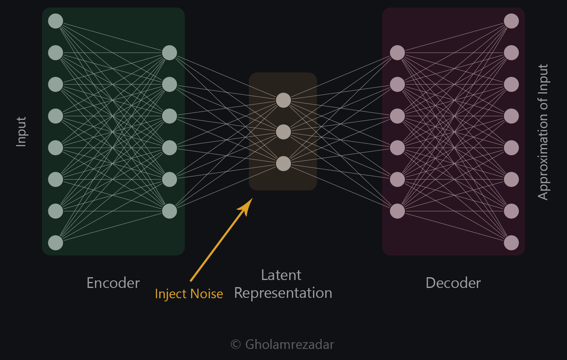
Denoising Auto Encoders
Injects noise to the latent representation
Goals:
Encourage the model to find more robust features
Discourage overfitting
Prevent the model from becoming a simple identity function
However, it gives a good idea of how to denoise images
© Y. Bengio et al. , "Extracting and Composing Robust Features with Denoising Autoencoders” 2008

Slide 10
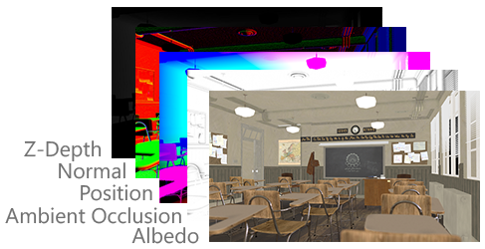
What is special about Ray traced images?
Easy access to auxiliary passes as additional input data
Similar to RGB-D cameras but way more powerful
Easily accessible training data
Need more data? Just make them*!
Customizable training data
Need more interior images? No problem*.
Need more night images? No problem*.
*needless to say that you still need the computing power to generate these data but it’s generally a lot easier than in other fields.
© “Classroom” scene by Christophe Seux, Renders by Gholamreza Dar

Slide 11

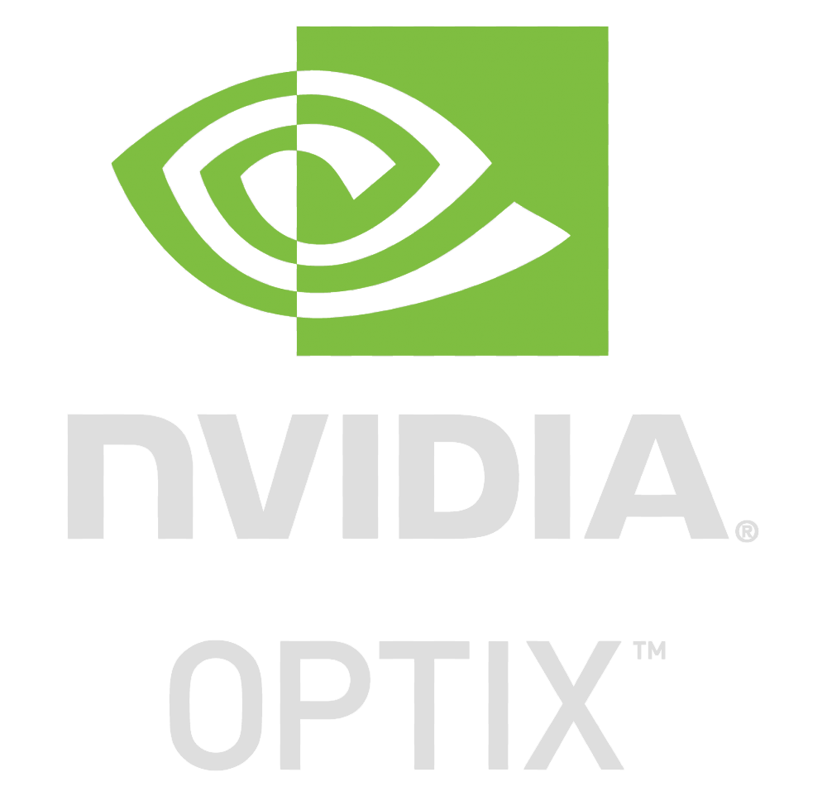
State of the art Methods
Intel® Open Image Denoiser (OIDN)
NVIDIA OPTIX™ Denoiser
Both of them are Autoencoder based
Both of them use said Auxiliary input data

Slide 12
Intel® OIDN Example
© “Classroom” scene by Christophe Seux, Renders and comparison by Gholamreza Dar

Slide 13
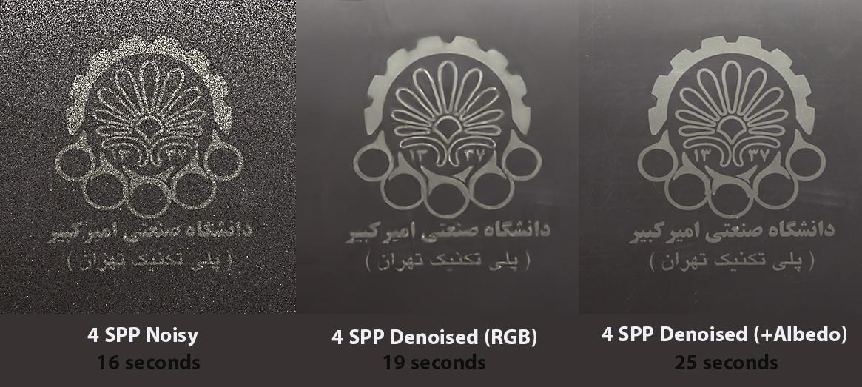
Effect of Auxiliary inputs
Zoomed in on the chalkboard
© “Classroom” scene by Christophe Seux, Renders and comparison by Gholamreza Dar

Slide 14
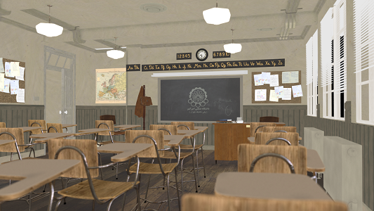
Albedo
Flat lighting and no shadows
© “Classroom” scene by Christophe Seux, Renders and comparison by Gholamreza Dar

Slide 15
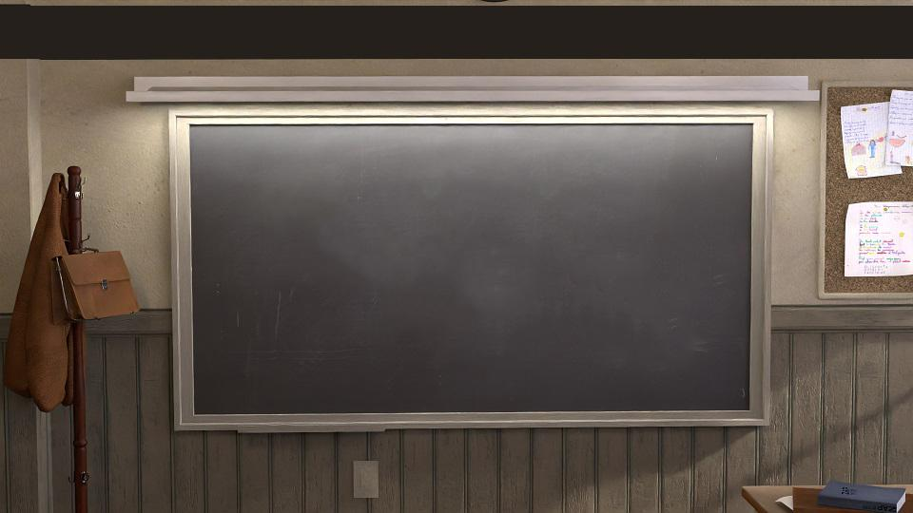
Conclusion
What are Ray traced images
Denoising Ray traced images is important
Autoencoders as the best method of denoising images
Benefits of working with Ray traced images
Practical examples

Slide 16
References
Open Image Denoise documentation
NVIDIA OptiX™ Ray Tracing Engine
Chakravarty et al. Interactive Reconstruction of Monte Carlo Image Sequences using a Recurrent Denoising Autoencoder, 2017 (Nvidia Research)
Vincent, Pascal, et al. "Extracting and composing robust features with denoising autoencoders." Proceedings of the 25th international conference on Machine learning, 2008.
Rumelhart, David E., Geoffrey E. Hinton, and Ronald J. Williams. Learning internal representations by error propagation. California Univ San Diego La Jolla Inst for Cognitive Science, 1985.
Alisha P B et al. Image Denoising Techniques-An Overview, 2016
Denoising autoencoders with Keras, TensorFlow, and Deep Learning - PyImageSearch
Auto Encoders and Style Transfer

Slide 17
Conclusion
Thank you for your time!

